Slide 1
More on Arrays
4th Grade Lesson 2
Division

Slide 2
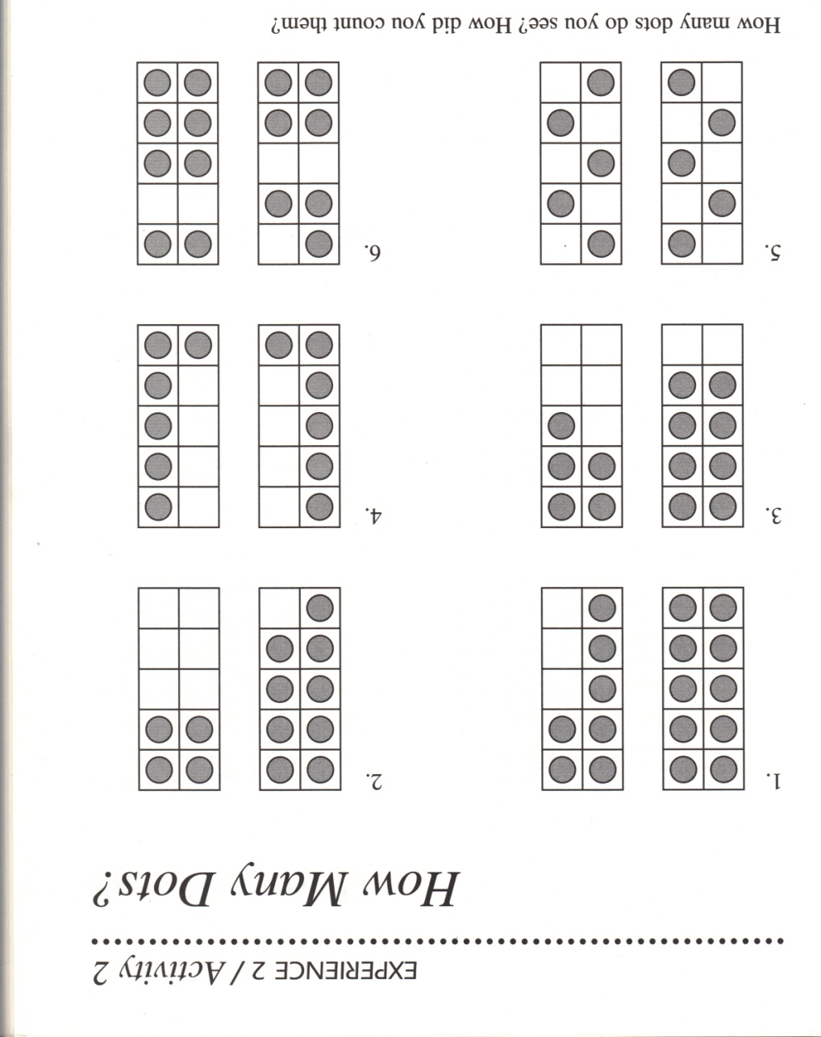
4th Grade Division

Slide 3
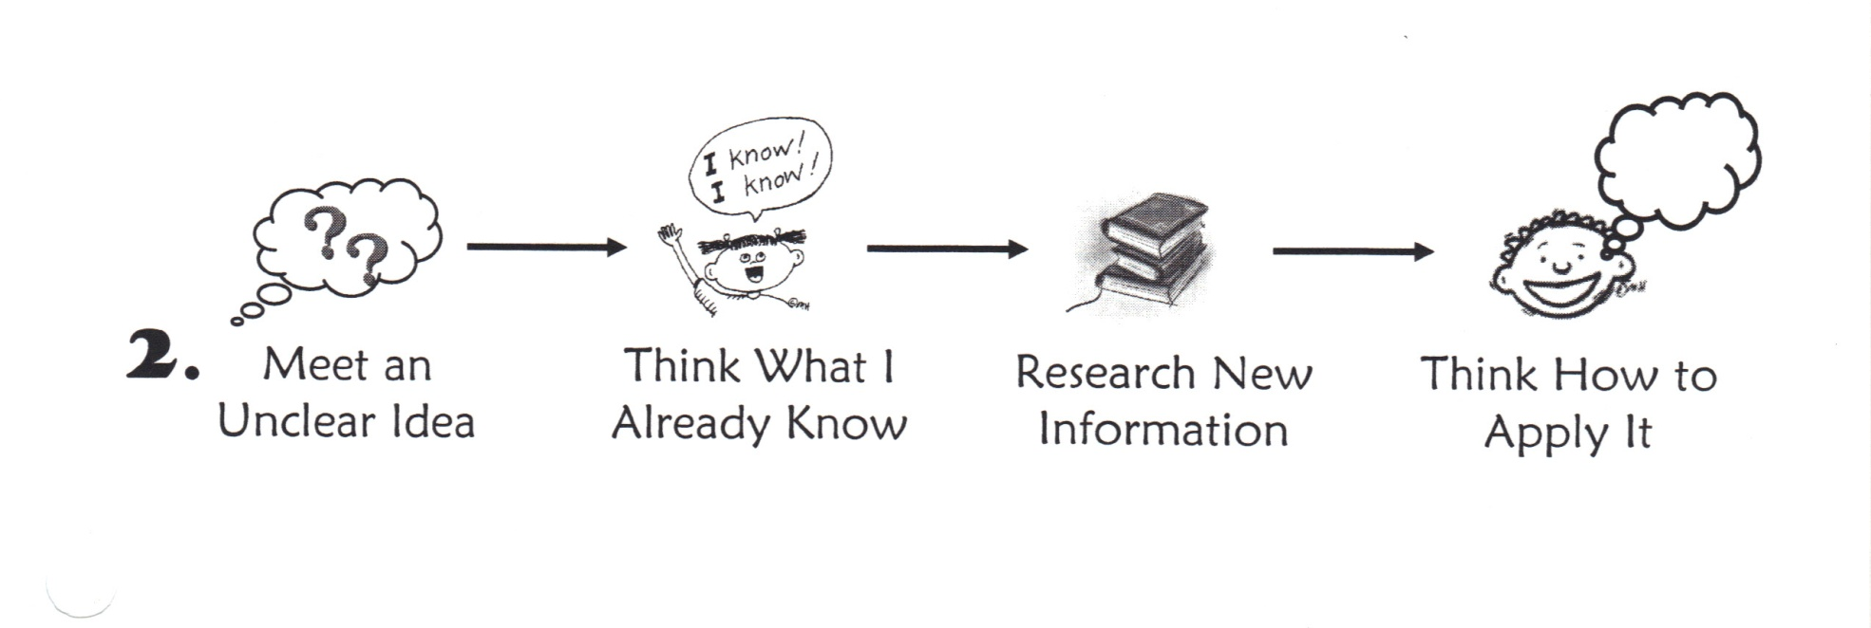
Experiment with information

Slide 4
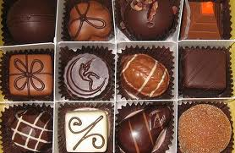

Slide 5
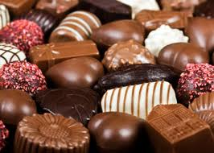

Slide 6
